Slide 1



Workshop
Azure OpenAI and Form Recognizer BPA accelerator to improve Document analysis

Slide 2
Agenda
Forms Recognizer - Overview and Experience
Azure OpenAI - Brief overview & Accessibility
Business Process Automation(BPA) Accelerator Capabilities & Usage
Develop and execute BPA pipeline with Form Recognizer
Analyze the output with Azure Search
Azure OpenAI usage to enhance the extracted information

Slide 3
“Again and again, we hunt for that document we urgently need and it is nowhere to be found. We have more data than ever before, but we struggle to navigate to the right data the moment we need it” –Everyone (at some point)
Notes:
[30s]
“Pause”
So, before we jump into the demos, let’s talk about “why” we might need this, and then, “what” we’re going to use it for, and “how” we’re going to do it.
Who can relate to this quote?
<<read the quote>>
There’s many challenges to deploying state-of-the-art deep learning models, from multiple domains, with real-world, messy data, at-scale

Slide 4
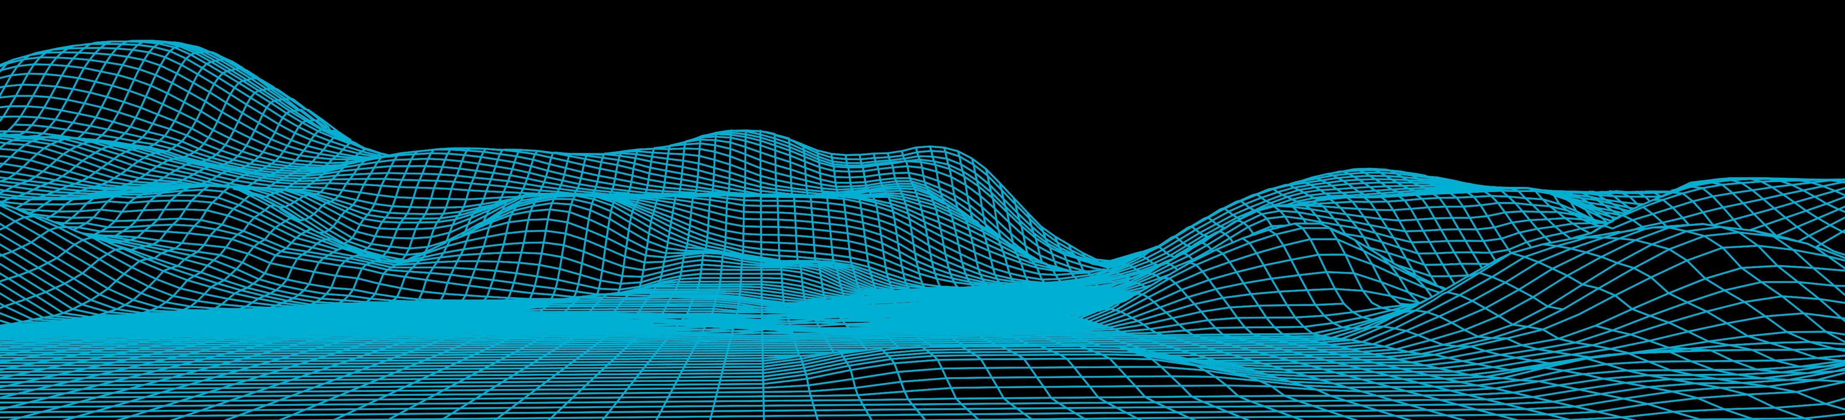
Challenges
Organizations amass many inputs:
which require AI expertise across multiple domains (NLP, CV, speech, ..)
Accelerator brings together multiple Cognitive Services together in a single studio/tool
Manual data entry and extraction could be costly and erroneous
Documents are everywhere, and are, unfortunately, still a major communication tool between organizations
Let the data scientists focus on AI. AI pipelines typically require developers and data scientists to develop and implement the solution, as well as long term management
Notes:
[30s]
There’s many challenges to deploying state-of-the-art deep learning models, from multiple domains, with real-world, messy data, at-scale
Many inputs:
PDF’s
machine documents
Images
emails, audio (calls) etc..
So how does BPA help?

Slide 5

















Azure AI Services
Applications
Partner Solutions
Business Users
Application Platform
AI Builder
Power BI
Power Apps
Power Automate
Power Virtual Agents
Scenario-Based Services
Applied AI Services
Bot Service
Cognitive Search
Form Recognizer
Video Indexer
Metrics Advisor
Immersive Reader
Customizable AI Models
Cognitive Services
Developers & Data Scientists
Vision
Speech
Language
Decision
OpenAI Service
ML Platform
Azure Machine Learning
Notes:
Narrative/talk track:
Azure AI is a collection of artificial intelligence services offered by Microsoft as part of its Azure cloud platform. The Azure AI services are designed to make it easy for developers and organizations to add AI capabilities to their applications, without the need for extensive expertise in AI.
Azure AI includes a wide range of services, such as:
Azure Cognitive Services: A collection of pre-built APIs that allow developers to add capabilities such as natural language understanding, computer vision, and speech recognition to their applications.
Azure Machine Learning: A cloud-based platform that allows developers to build, deploy, and manage machine learning models, as well as to create custom machine learning algorithms.
Azure Applied AI Services: A suite of scenarios-based services that enable organizations to accelerate adoption such as Azure Cognitive Search which provides search capabilities over structured and unstructured data by using machine learning models.
These services are integrated with Azure platform, which provides capabilities such as scalability, security, and compliance, as well as a number of other tools and services that can be used to build and deploy AI-enabled applications.
The Azure AI services are designed to make it easy for developers and organizations to add AI capabilities to their applications, without the need for extensive expertise in AI. Microsoft's Azure AI services allow developers to quickly build, deploy, and scale AI-enabled applications, and to take advantage of the scalability, security, and compliance capabilities of Azure.
Azure AI integration in AI Builder within the Microsoft Power Platform allows businesses and developers to quickly and easily build and deploy custom AI models, and to integrate them with Power Apps, Power Automate and Power Virtual Agents, in order to add advanced capabilities and improve data management and security. It also allows to easily scale up and improve performance of the models, as well as easily integrating with other Azure services.
Microsoft has adopted Azure AI across a wide range of its products and services, in order to improve the functionality, performance and user experience. Some examples of where Microsoft has adopted Azure AI at scale include:
Office 365: Microsoft has integrated Azure AI capabilities into Office 365, such as natural language processing, computer vision, and text analytics, to improve the functionality of products such as Outlook and Word. This allows users to perform tasks such as automatically summarizing long documents, or automatically tagging images in email attachments.
Dynamics 365: Dynamics 365 is a collection of business applications that enable organizations to manage customer data and interactions, as well as automate business processes. With Azure AI integration, Dynamics 365 offers features like predictive lead scoring, sentiment analysis, and chatbots to help businesses better understand and interact with their customers.
Bing: Bing, Microsoft's search engine, uses Azure AI to analyze large amounts of data and improve search results for users. For example, Bing uses natural language processing to understand users' queries and generate more relevant search results.
LinkedIn: Microsoft's professional networking site, LinkedIn, uses Azure AI to help users find job opportunities, connect with others in their field, and improve the performance of its recruiting tools. For example, LinkedIn uses natural language processing to match job seekers with relevant job opportunities, and uses machine learning to help recruiters find the best candidates.
Xbox and Gaming: Microsoft uses Azure AI to power its Xbox gaming console. Azure AI allows Xbox to learn a gamer's preferences and automatically adjust the gaming experience. Additionally, it allows to improve the performance of the games and to offer more personalized gaming experiences.
These are just a few examples of how Microsoft has adopted Azure AI at scale within its products and services. Overall, Microsoft has been using Azure AI across its various products and services, to improve user experience and to offer more personalized, efficient and automated experiences to its customers.

Slide 6

Azure Form Recognizer Overview
Cloud-based service that uses machine-learning models to extract and analyze form fields, text, and tables from your documents.
It easily identifies, extracts, and analyzes the following document data:
Table structure and content
Form elements and field values
Typed and handwritten alphanumeric text
Relationships between elements
Key-value pairs
Element location with bounding box coordinates

Slide 7

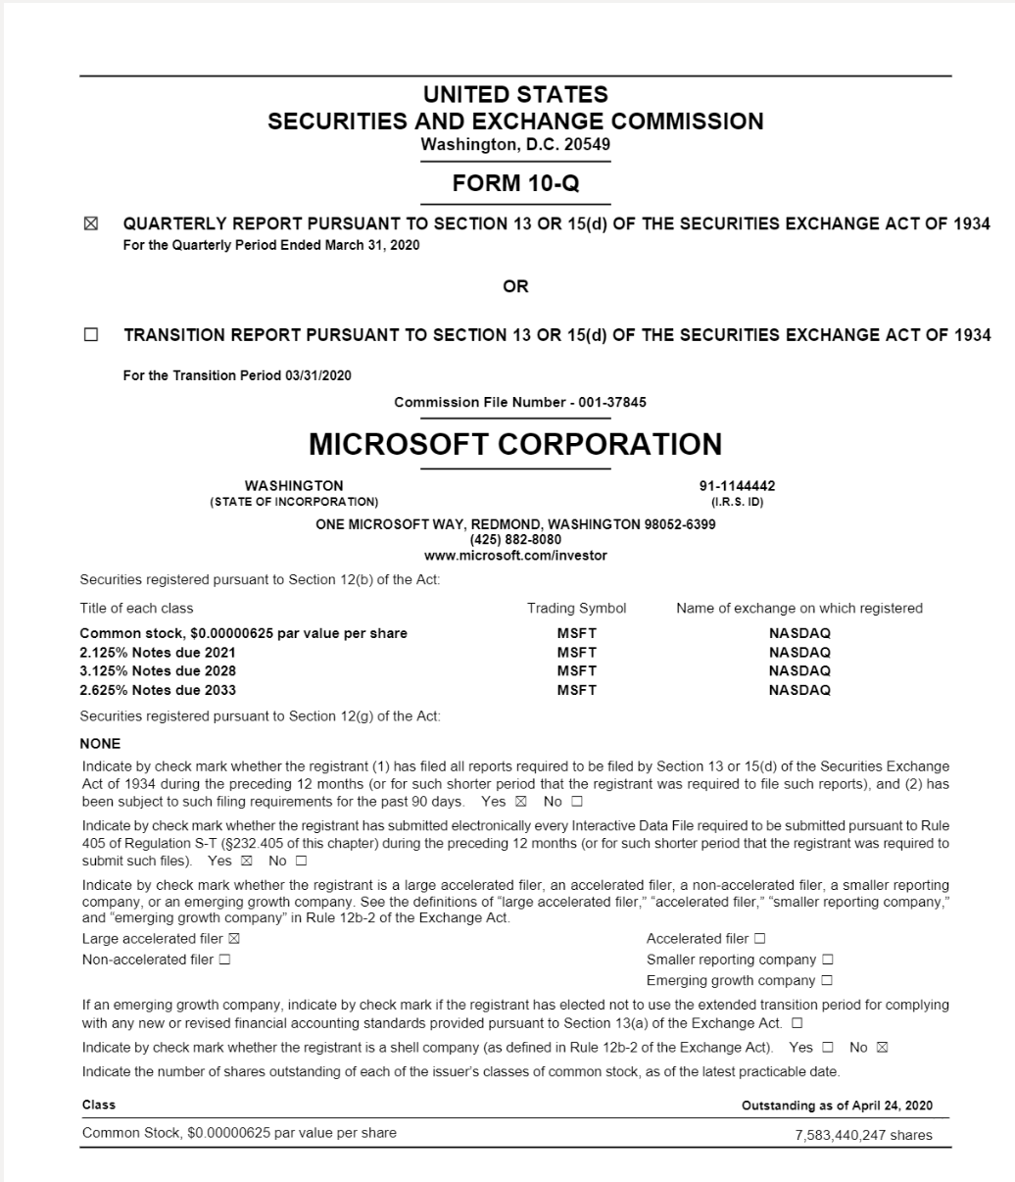
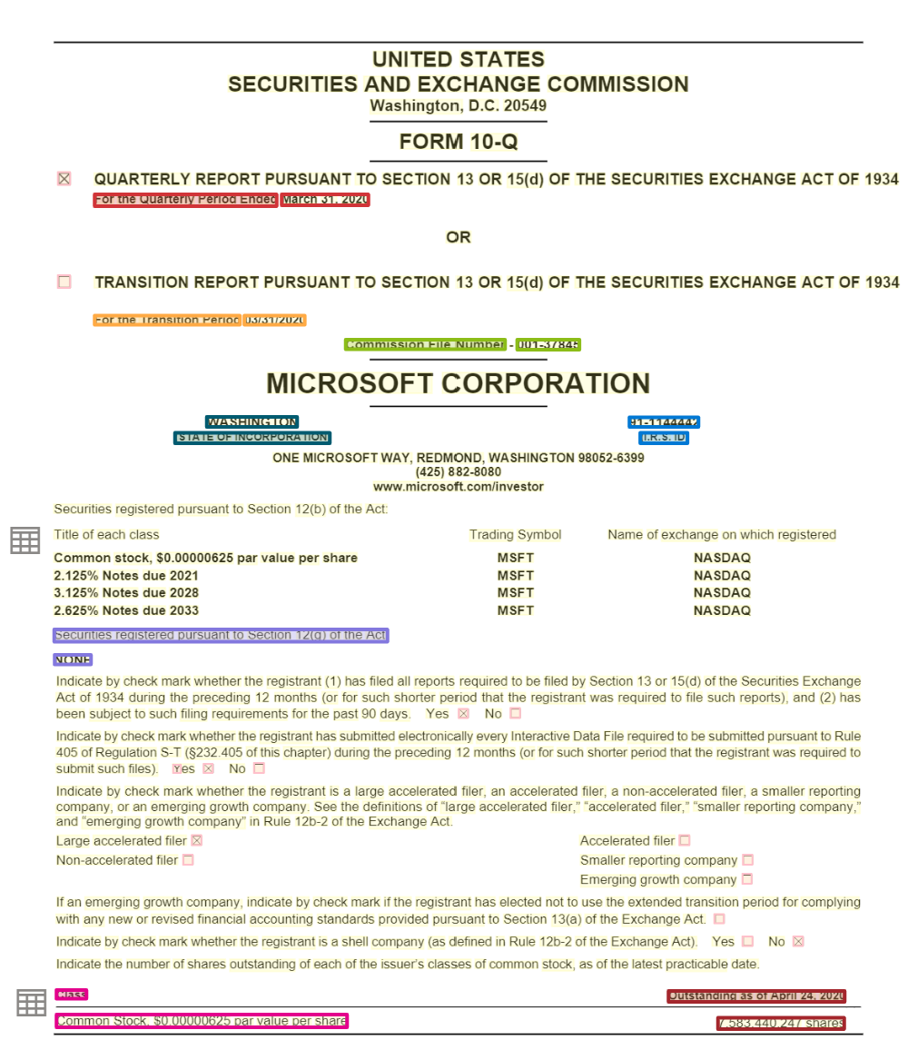
Form Recognizer
Extracts information from documents and turns unstructured content into business ready structured content
Text
Structure
Tables
Key Value Pairs
Entities
READ
LAYOUT
DOCUMENT
PREBUILT
CUSTOM
Automatic text extraction from documents (PDFs, Images, Word, HTML) for printed and handwritten documents for 164 languages
Automatic document structure extraction – lines, paragraphs, tables, selection marks, barcodes
Automatic document understanding from unstructured and structured documents extract Key value pairs and entities
Automatic understanding of Invoices, receipts, business cards, W2, IDs, Health Insurance Cards, Vaccine Cards.* and lots more coming soon
Train a custom model tailored to your documents. Get started with 5 documents only

Slide 8



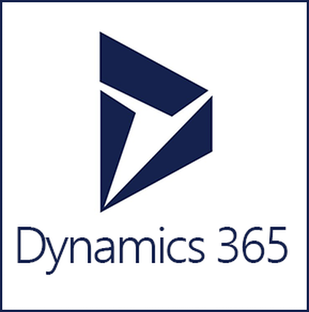




How it works
Ingest Documents
Form Recognizer Document Understanding
Consume
Layout
Prebuilt
Custom
images
Pre-Processing
de-noising (improve resolution), background noise, watermarks removal
General Documents
Invoices
Templates
Train a model for structured documents
Text Extraction
Character, word, line, blocks read order bounding boxes
handwritten \ printed
ID
PDF
Insurance Cards
Segment analysis
Paragraphs, sections, headers, table of contents etc.
W2
Neural Model
Train a model for unstructured document
Word
Vaccine Cards
Structure Recognition
Tables, selection Marks
Barcodes, images
Receipts
Health Insurance Cards
Only a handful of documents needed to get started and train a model
HTML
And more

Slide 9

Form Recognizer Studio Layout, Prebuilt and General Document models

Slide 10
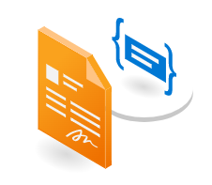
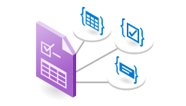

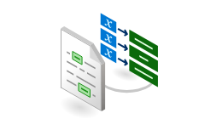
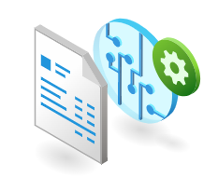
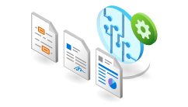
Form Recognizer capabilities
Read
Layout
Prebuilt[s]
General key
value pairs
Template
models
Neural models
Prebuilt models for ID, receipts, invoices, W-2 and more
Pretrained mode to extract key value pairs and entities from documents
Train a model in minutes to extract specific key value pairs. Documents with consistent structure
Train a model to extract key value pairs from unstructured documents
Extract text from documents
Extract text & structure from documents

Slide 11
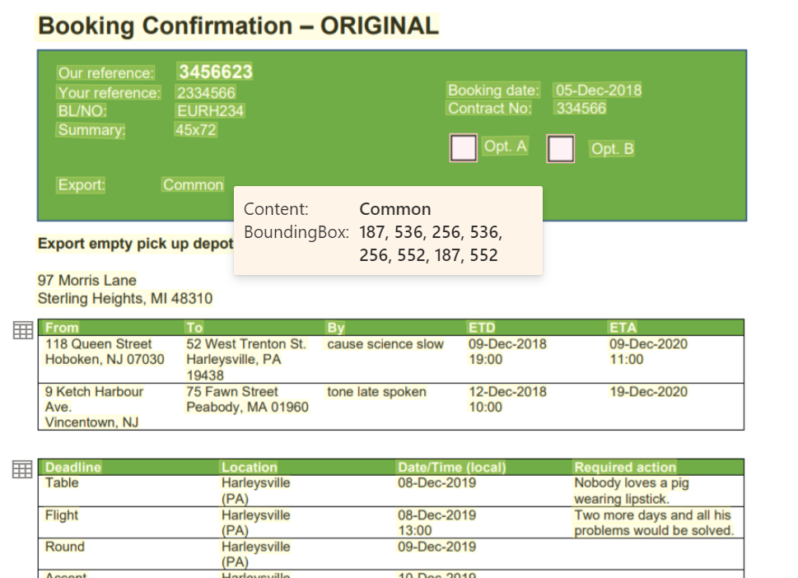
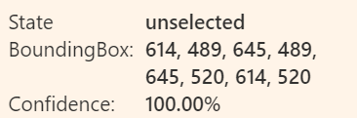
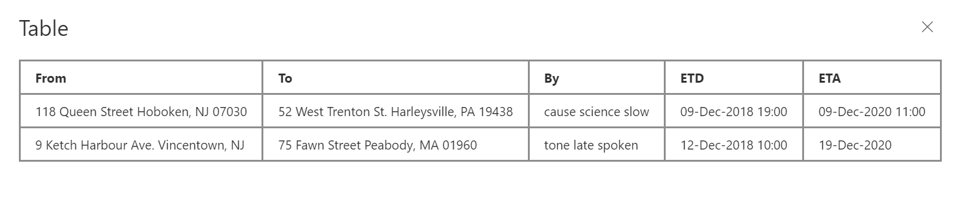
Layout
Extract text and their locations
Extract structural elements like tables and selection marks
Extracts print and handwritten text for the full list of supported languages
More structural elements like titles, headers, footers, paragraphs, captions coming soon.

Slide 12
164 languages
English
French
Italian
German
Spanish
Portuguese
Dutch
Chinese Simplified
Chinese Traditional
Japanese
Korean
Czech
Hungarian
Polish
Swedish
Turkish
Danish
Norwegian
Cebuano
Fijian
Swahili (Latin)
Uzbek (Latin)
Zulu
Afrikaans
Albanian
Indonesian
Malay (Latin script)
Filipino
Catalan
Galician
Basque
Haitian Creole
Irish
Javanese
Scottish Gaelic
Scots
Romansh
Luxembourgish
Occitan
Breton
Asturian
Neapolitan
Western Frisian
Corsican
Friulian
Manx
Kara-Kalpak
Gilbertese
Bislama
Kachin (Latin script)
Khasi
Hani
Greenlandic
Tetum
Zhuang
Volapük
Interlingua
Kabuverdianu
Cornish
Hmong Daw (Latin)
Inuktitut (Latin)
K’iche’
Yucatec Maya
Estonian
Finnish
Slovenian
Kashubian
Kurdish (Latin)
Tatar (Latin)
Crimean Tatar (Latin)
Chamorro
Upper Sorbian
Walser
Azerbaijani (Latin Script) Belarusian (Latin Script) Bosnian (Latin Script) Croatian Faroese Gagauz (Latin script)
Hawaiian Icelandic Inari Sami
Kazakh (Latin Script)
Kosraean Lakota Latin Lithuanian Lower Sorbian Lule Sami Maltese Maori
Montenegrin (Latin Script) Niuean Northern Sami (Latin script) Ripuarian Romanian Samoan (Latin script) Serbian (Latin Script) Russian Bulgarian Ossetic Kazakh (Cyrillic Script) Kyrgyz (Cyrillic Script) Mongolian (Cyrillic Script) Montenegrin (Cyrillic Script) Tajik Uzbek (Cyrillic Script) Belarusian (Cyrillic Script) Karachay-Balkar
Koryak Buryat (Cyrillic Script) Tuvan Kara-Kalpak (Cyrillic Script)
Kumyk (Cyrillic Script)
Nogay Erzya (Cyrillic Script)
Skolt Sami Slovak
Southern Sami Tongan Turkmen (Latin script) Welsh
Hindi
Marathi
Nepali
Haryanvi
Sanskrit
Bhojpuri-Hindi (Devanagari Script)
Bundeli
Angika (Devanagari Script)
Awadhi-Hindi (Devanagari Script)
Bagheli
Mahasu Pahari (Devanagari Script)
Brajbha
Bodo (Devanagari Script)
Dhimal (Devanagari Script)
Dogri (Devanagari Script)
Gondi (Devanagari Script)
Gurung (Devanagari Script)
Halbi (Devanagari Script)
Chhattisgarhi (Devanagari Script)
Ho(Devanagiri Script)
Jaunsari (Devanagari Script)
Korku
Khaling
Malto(Devanagari Script)
Kurukh (Devanagari Script)
Chamling
Santali(Devanagari Script)
Sadri (Devanagari Script)
Sirmauri (Devanagari Script)
Thangmi
Kangri (Devanagari Script)
Sherpa (Devanagari Script)
Arabic
Kurdish (ku)
Panjabi (pa)
Persian (fa)
Dari (prs)
Pushto (ps)
Somali (so)
Uyghur (ug)
Urdu(ur)
Uzbek (uz)

Slide 13
Train a custom model Template and Neural models

Slide 14
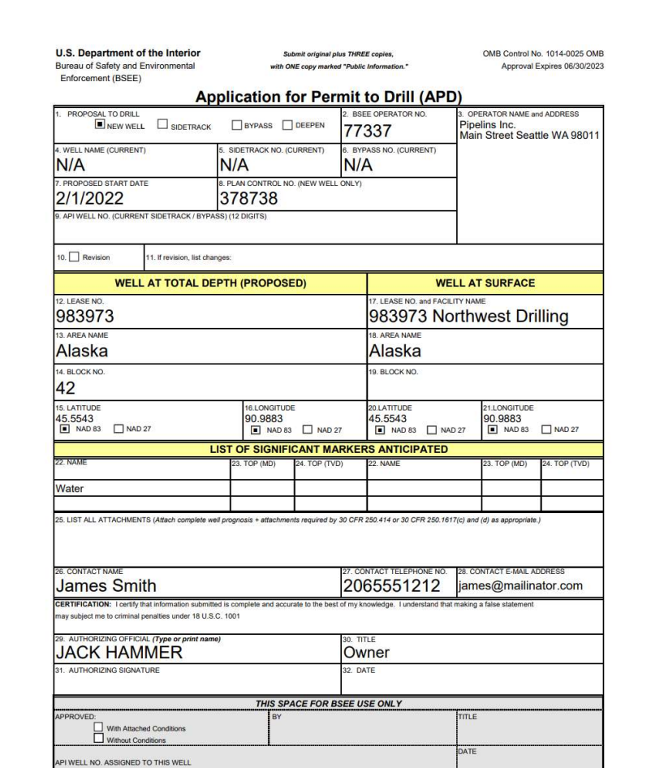
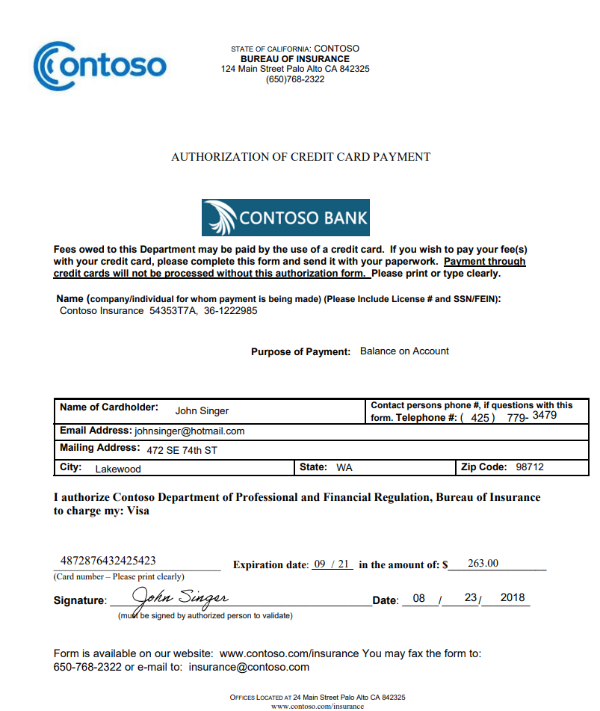
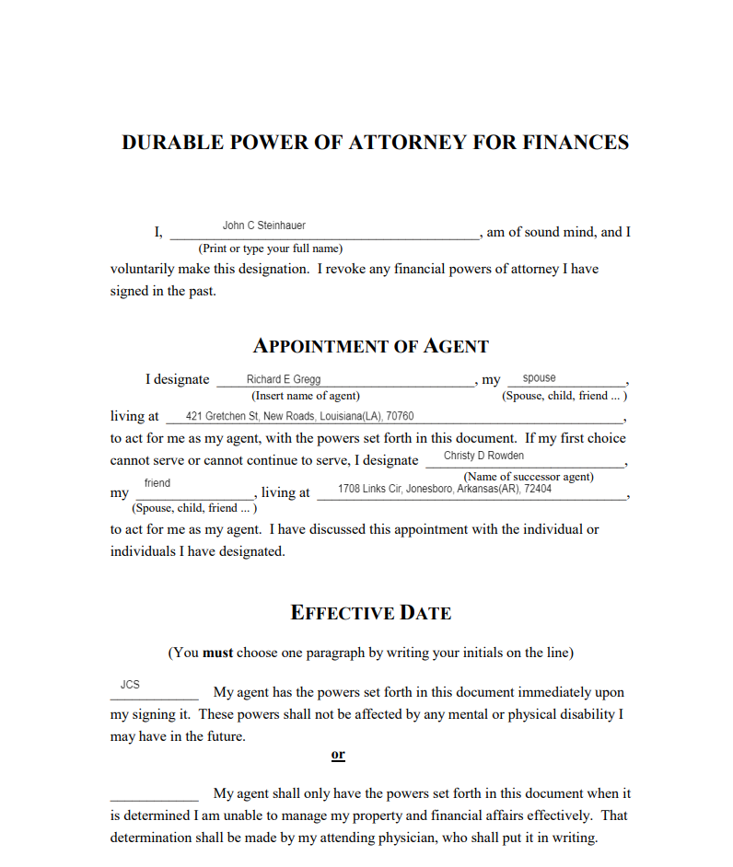
Forms or Documents
Structured
Semi-Structured
Unstructured
Template
Neural

Slide 15






Choosing the right model
Template (custom form)
Neural (custom document)
Structure
Template/Form/Structure based extraction
Structured, semi structured and unstructured
Training Time
1- 5 min
30 min – 1 hour
Key value pairs, Tables, Selection Marks, Signatures, Regions
Key value pairs, Selection Marks
Features
Requires a model per variation
Single model for all variations
Variations
Multiple (see supported languages)
English only
Languages
Generated during training
Requires a validation dataset to be computed
Accuracy

Slide 16
Composed Custom Models
Composed models
Collection of custom models and assigning them to a single model built from your form types
With the model compose operation, you can assign up to 200 trained custom models to a single composed model
For custom template models, the composed model can be created using variations of a custom template or different form types
For Custom neural models, the best practice is to add all the different variations of a single document type into a single training dataset and train on custom neural model

Slide 17

Azure Open AI

Slide 18

Generative AI
Content creation by API
Prompt
Write a tagline for an ice cream shop.
Prompt
I’m having trouble getting my Xbox to turn on.
Prompt
Table customers, columns = [CustomerId, FirstName, LastName, Company, Address, City, State, Country, PostalCode]
Create a SQL query for all customers in Texas named Jane
query =
Prompt
A ball of fire with vibrant colors to show the speed of innovation at our media and entertainment company
Response
There are a few things you can try to troubleshoot this issue … …
Response
We serve up smiles with every scoop!
Response
Prompt
Thanks! That worked. What games do you recommend for my 14-year-old?
Response
SELECT *
FROM customers
WHERE State = 'TX' AND FirstName = 'Jane'
Response
Here are a few games that you might consider: …
Notes:
This slide shows three simple examples of how the Azure OpenAI Service allows you to generate content using the API.
You can build prompts that ask it to generate text, database queries, or images.
Now where the real magic can happen is when you customize Azure OpenAI with your business data.

Slide 19
AOAI Models
Models | Description
GPT-4 | A set of models that improve on GPT-3.5 and can understand and generate natural language and code.
GPT-3.5 | A set of models that improve on GPT-3 and can understand and generate natural language and code.
Embeddings | A set of models that can convert text into numerical vector form to facilitate text similarity.
DALL-E (Preview) | A series of models in preview that can generate original images from natural language.
Whisper (Preview) | A series of models in preview that can transcribe and translate speech to text.

Slide 20


Azure OpenAI | Top 4 Capabilities & Use Cases
Content Generation
Summarization
Code
generation
Semantic Search
Call Center Analytics: Automatically generate responses to customer inquiries
Call Center Analytics: Summary of customer support conversation logs
Convert Natural Language to SQL (or vice versa) for telemetry data
Search reviews for a specific product / service
Generate personalised UI for your website
Subject Matter Expert Document Summarization (e.g. financial reporting, analyst articles)
Convert Natural Language to Query Proprietary Data Models
Information Discovery and Knowledge Mining
Social Media Trends Summarization
Code Documentation
Examples of Multiple Model Use Cases
End to End Call Center Analytics: Classification, Sentiment, Entity Extraction, Summarization and Email Generation
Customer 360: Hyper-personalisation using timely Summarization of customer queries & trends, Search, and Content Generation
Business Process Automation: Search through structured & unstructured documentation, Generate Code to query data models, Content Generation
Notes:
Narrative/talk track:
But based on our work with customers on OpenAI, we find 4 capabilities that seem to stand out: Content generation, Summarization, Code Generation and Semantic Search.
Content generation has sparked a lot of interest among those who want to be able to automate responses to customers, or generate personalized UI for their company’s website or with recruitment firms who want to be able to generate content for bringing in their ideals applicants.
The second popular capability of OpenAI has been summarization. There’s so much goodness here for call center analytics scenarios where companies would want to summarize conversation logs, or to be able to summarise long and tedious reports or tonnes of analyst articles. Social media trend summarization is another use that is important for companies to know what their customers are heading towards and what their industry is trending towards.
Code generation – the third popular capability…. Think of wanting to convert your SQL to NL or vice versa. Code generation is powerful capability that can help to convert code, as well as generate text and source code directly into your application.
Last but not the least, Semantic Search with OpenAI will help quicken the time to search through documents.
These use cases are particular to these 4 categories or capabilities of OpenAI that we are discussing here. IN addition to these, we also have some examples of multiple model use cases that are very popular among our customers:
End to end call center analytics that takes your process all the way from classification through to email generation to increase productivity and save time and effort during call center operations.
Customer 360 where hyper-personalization will use more than one of the above capabilities to ensure you have a complete and holistic view of your customers and are increasing your customer satisfaction, whilst using feedback and trends to serve them better in the future.
Business Process Automation like document automation where we use capabilities across search, code generation and content generation to do things faster and more efficiently.

Slide 21
Hands On Labs
Form Recognizer
Azure Search
Azure OpenAI

Slide 22
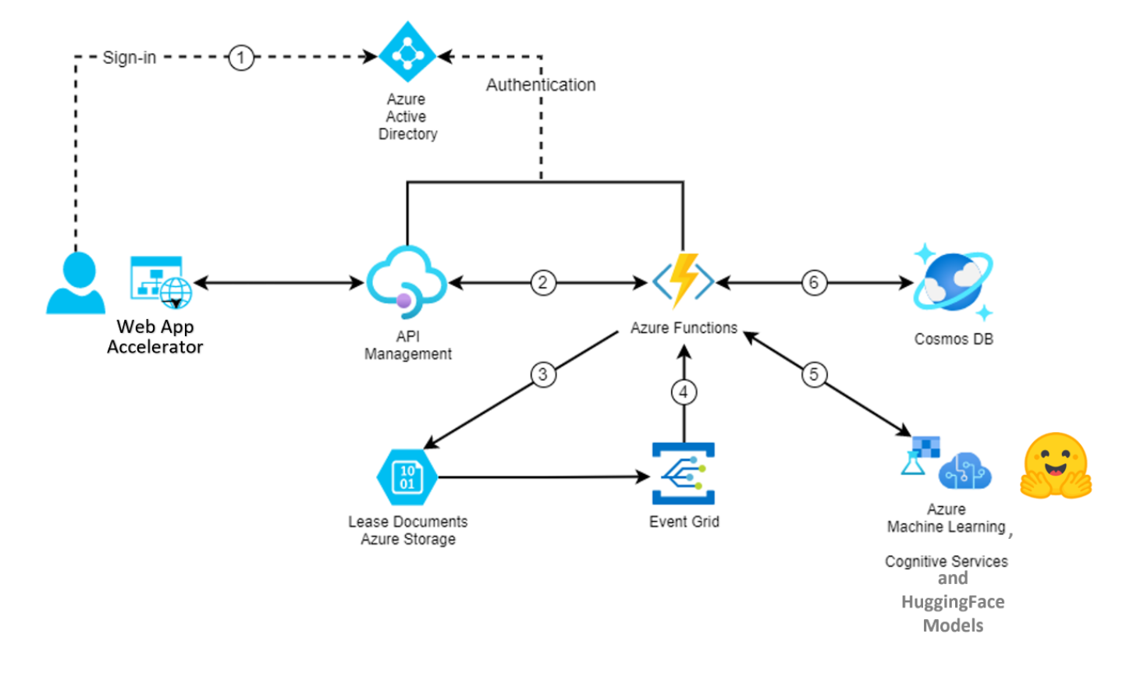
BPA Architecture Lab setup

